Slide 2



Slide 3
Software Development Methodologies
Waterfall Model
Prototype Methodology
Agile Methodology
Rapid Application Development
Dynamic System Development Model Methodology
Spiral Model
Extreme Programing Methodology
Feature Driven Development
Joint Application Development Methodology
Lean Development Methodology
Rational Unified Process Methodology
Scrum Development Methodology

Slide 4

Which methodology is better?

Slide 6

Estimation should be done by team
not manager

Slide 7

2. Plan the time when product will be released

Slide 14
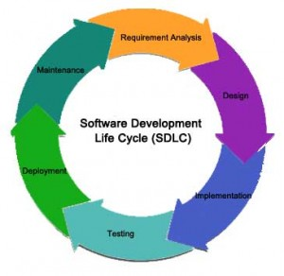

Slide 15
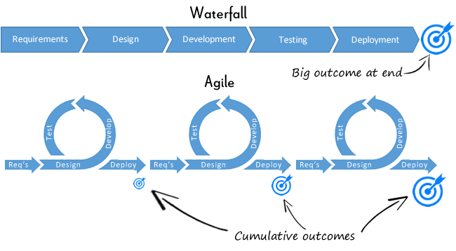

Slide 16
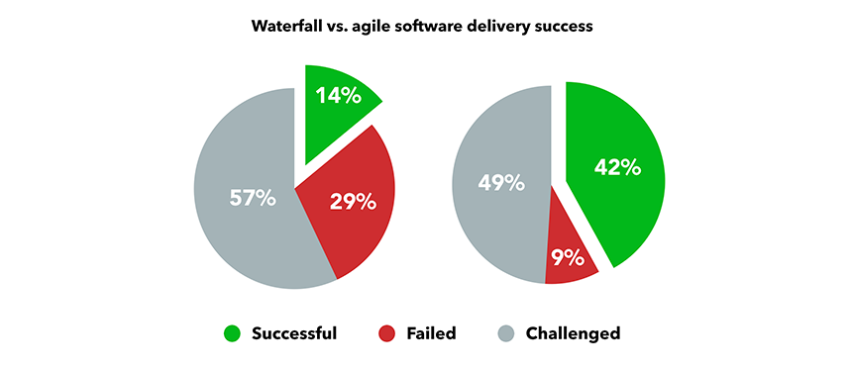

Slide 17
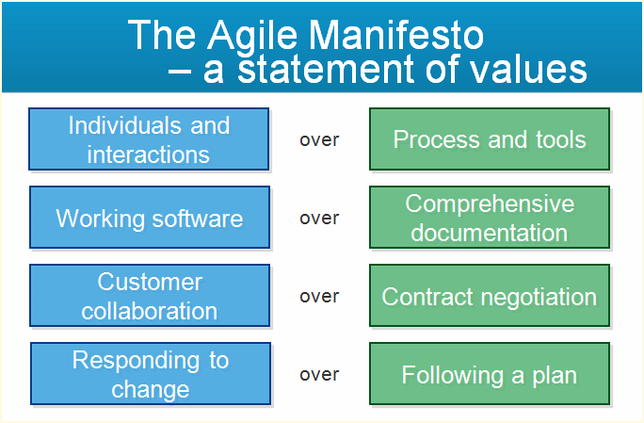

Slide 18
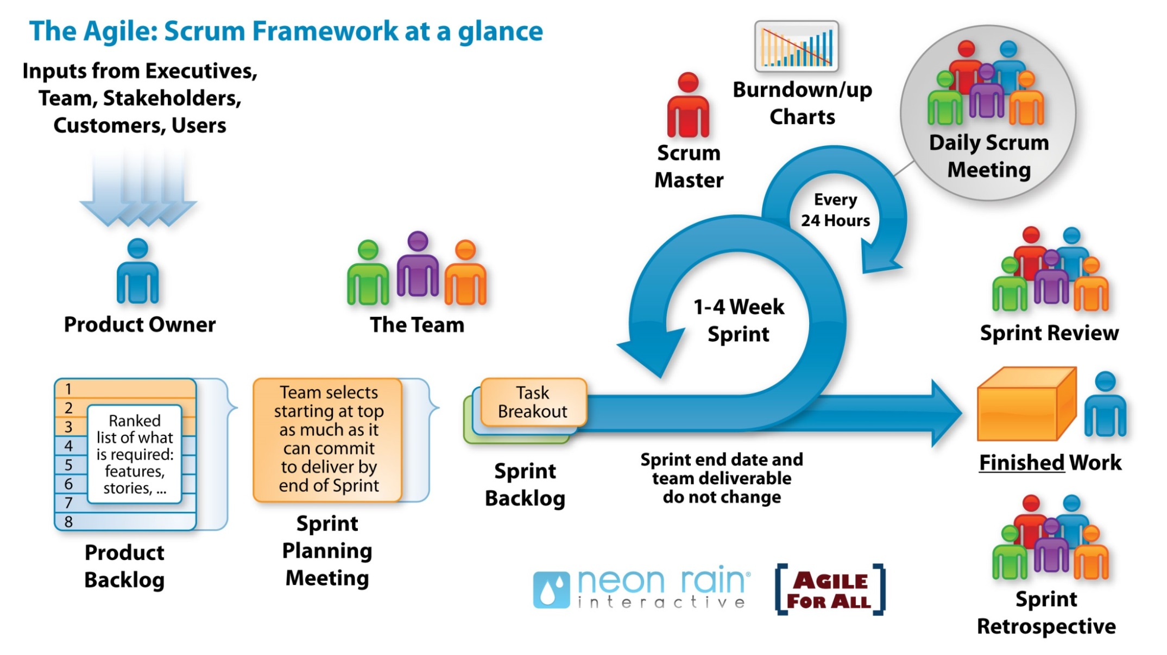

Slide 19




Slide 25

Meeting
Planning Meeting
Daily Standup Meeting
Sprint Review
Sprint Retrospective
Daily 15 minutes
Issues:
What have I done?
What will I do?
What is my problem?
For the Product Owner
For the customers.
At the end of each sprint
Analysis of the work done
At the end of sprint
What is a Product Backlog?
What can we do?
Further details?
Who will do it?
How long will it take?

Slide 26
https://www.youtube.com/watch?v=502ILHjX9EE

Slide 27
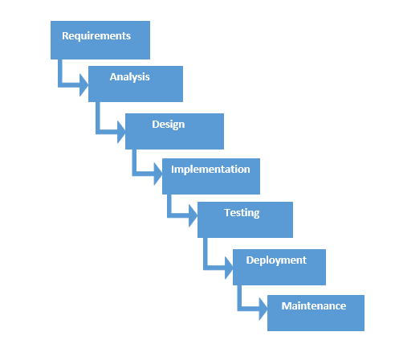

Slide 33
